Slide 1
UNIT 3: UNDERSTANDING THE STRUCTURE AND CONSTRUCTION OF NEWS

Slide 2
PRESENTED BY:-
KASHISH KANWAR
MEDHAVI DUBEY
ANKITA BAIDYA
KASHISH GUPTA
NANCY
KASHISH MANSOORI
MOULI SHARMA
(GROUP-3)

Slide 3
Organizing a News Story and 5Ws and 1H

Slide 4

Organizing a News Story What is "News"?
This Photo by Unknown author is licensed under CC BY-NC-ND.
News is a newly received or noteworthy information, especially about recent events.
It is a new piece of data about any happening provided to a significant amount of interested audience.
News is anything that is treated with excitement by people and gets talking about.

Slide 5
Hard News :-
Refers to the news stories that have a big impact on society as a whole and needed to be reported urgently.
Soft News :-
Soft news refers to stories that provide other background information about entertainment news, world events.

Slide 6

SOME SOURCES OF NEWS
INTERNET
NEWSPAPER
RADIO
TELEVISION

Slide 7

5Ws and 1H
5Ws are ;-
Who – refers to the person in limelight
What – refers to the occurrence which makes the item worth reporting
Where – refers to the place of the occurrence
When – refers to the time of the occurrence
Why – refers to the motive behind the occurrence
1H is ;-
How – refers to the method by which something is accomplished
This Photo by Unknown author is licensed under CC BY.

Slide 8
Inverted Pyramid and Do’s and Don’ts

Slide 9
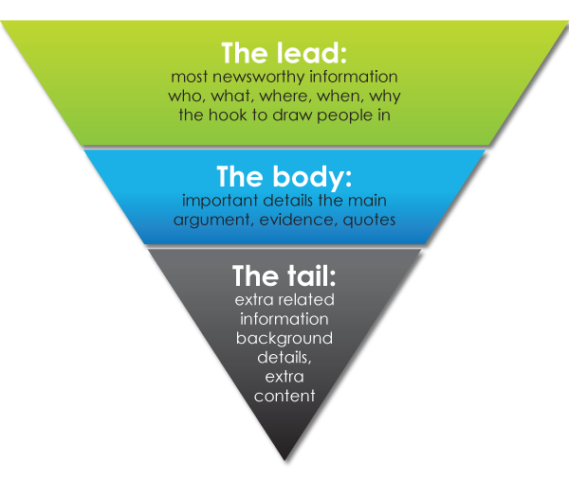
Inverted Pyramid

Slide 10

The inverted pyramid tells the basic rules to the journalist so that he can frame the news in the best way possible. Inverted Pyramid is the perfect way through which news is articulated in an ordered and structured manner.
This method deals with analyzing the most important data and writing in a way so that the reader gets the most crucial data first and then arranging the information in descending order of importance.

Slide 11
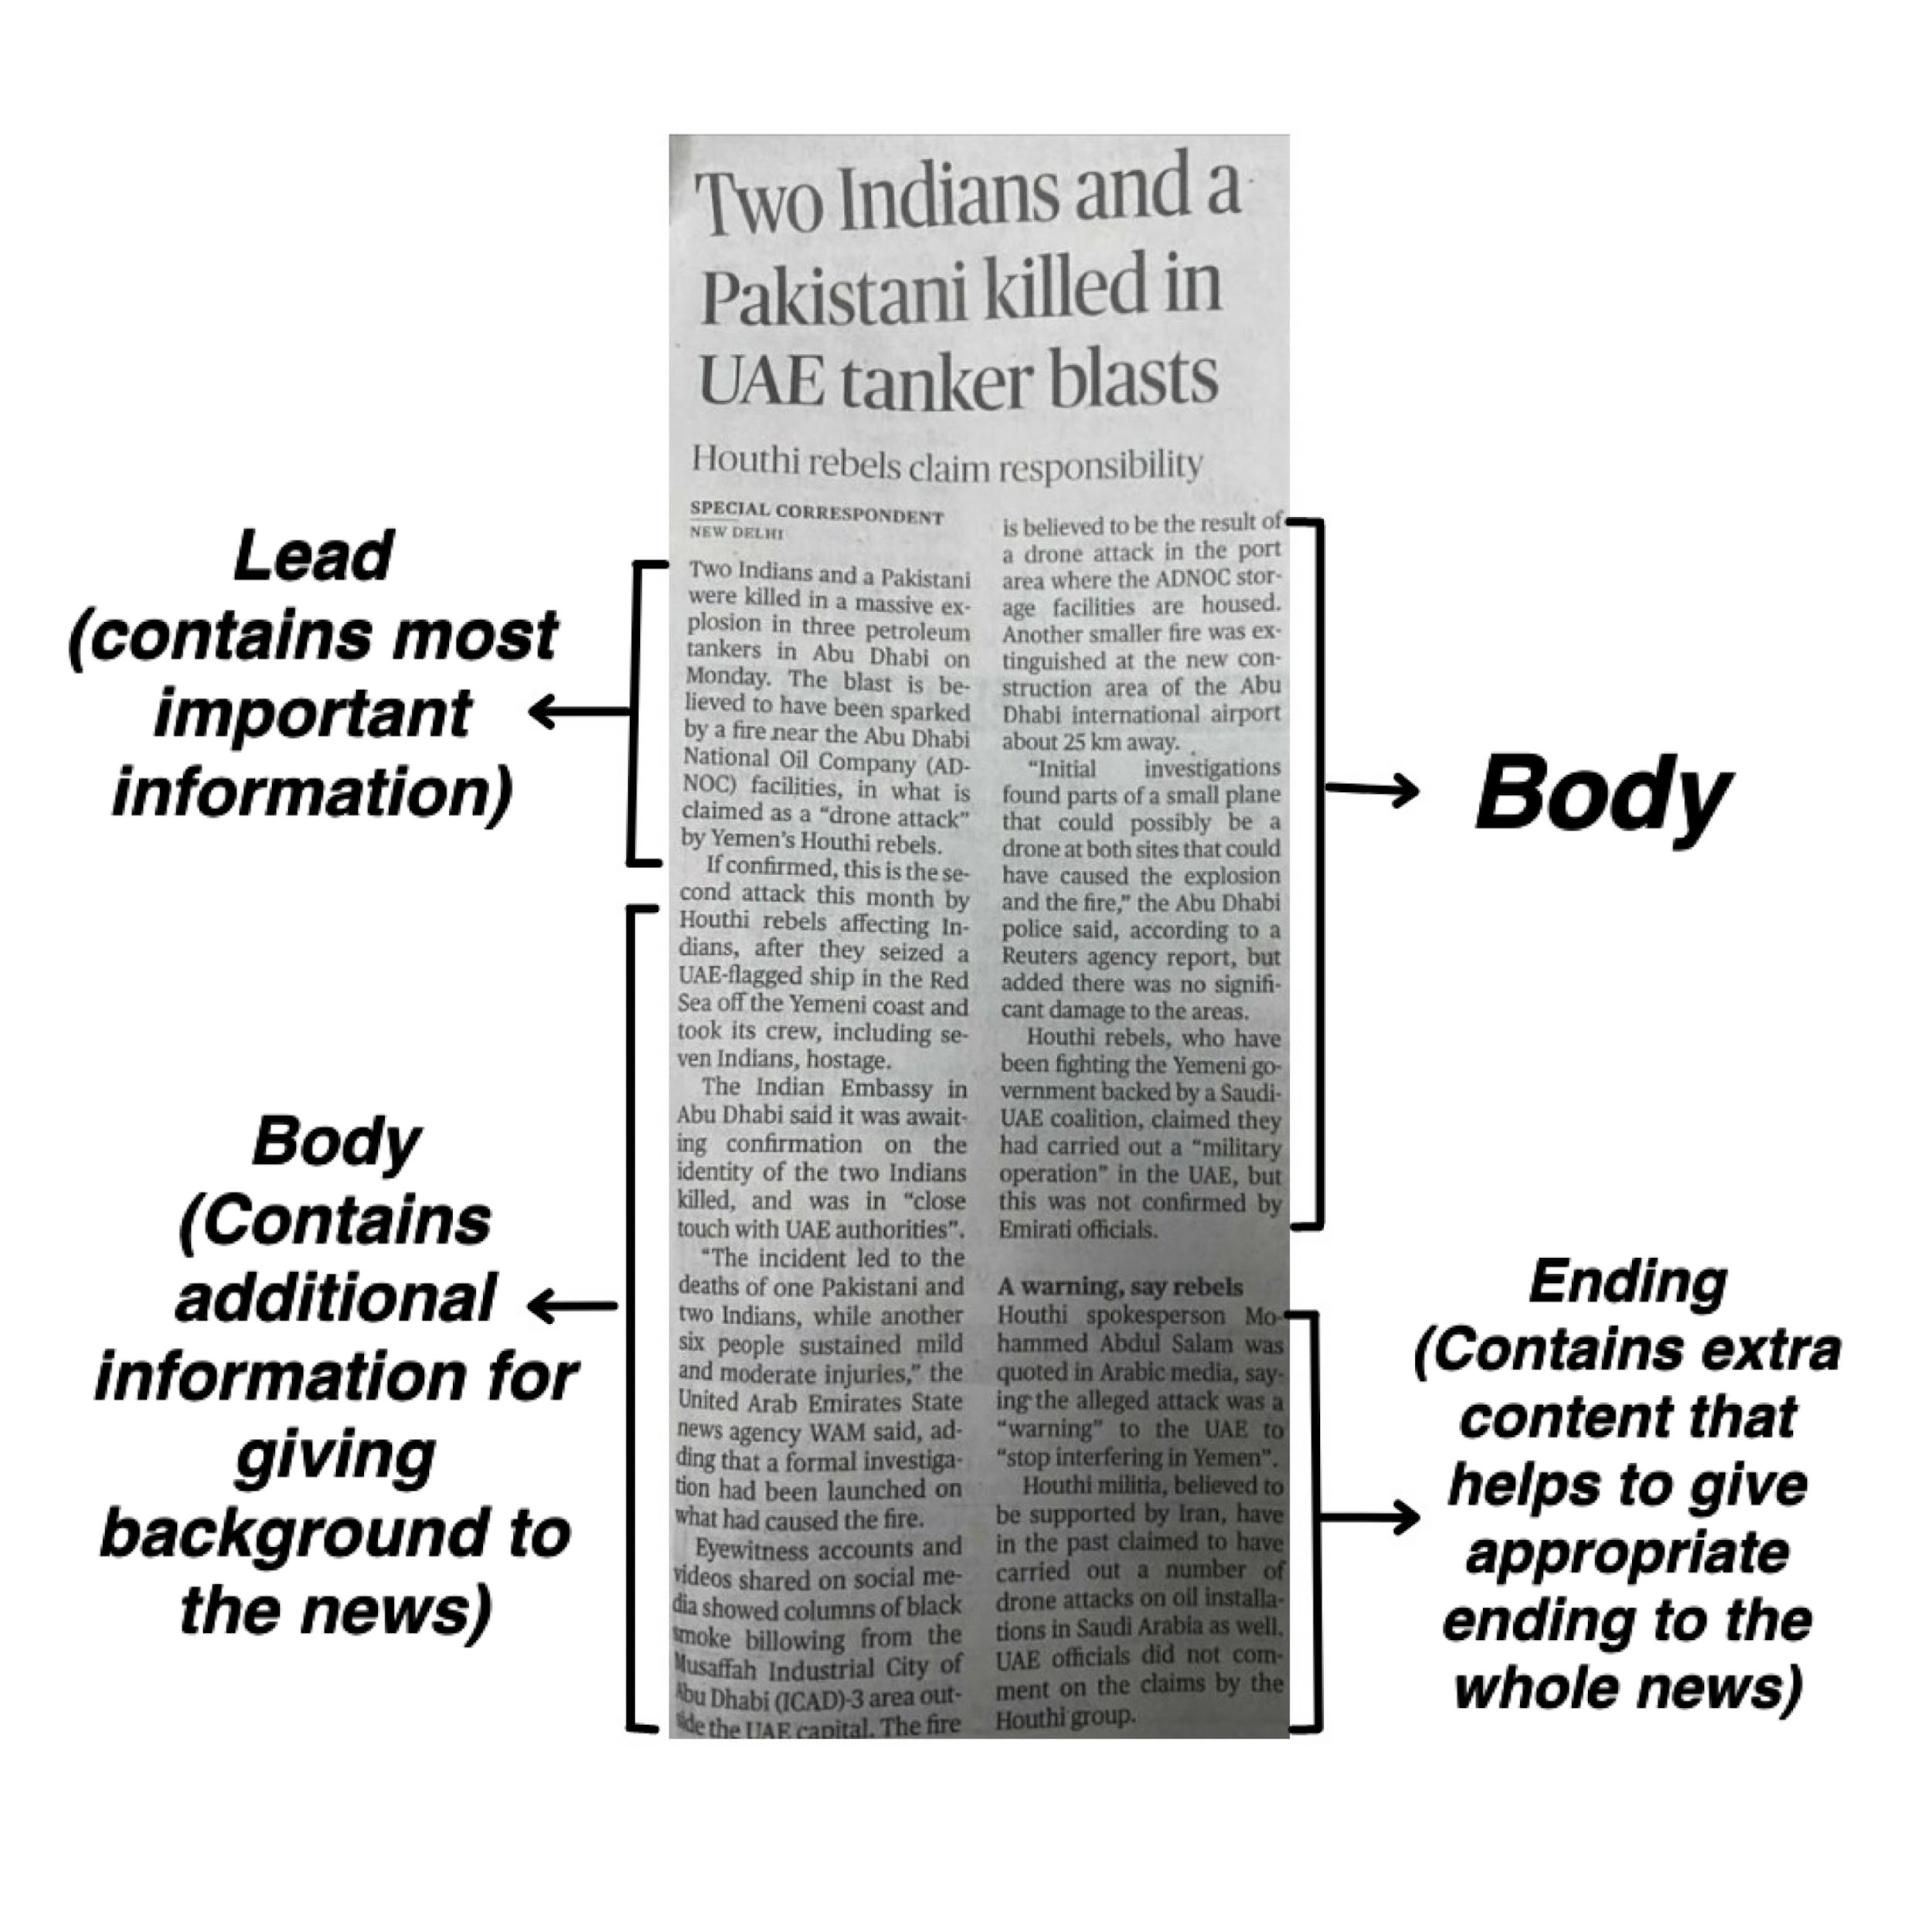

Slide 12

Contents
Next comes the body that contains additional and extra information which is not so critical that it must be added in the lead. It must contain supporting and that kind of information that uplifts the whole news as the reader will get more elaborative knowledge about a particular event and incident.
The first paragraph which is known as the lead is the most attention-grabbing as it is the first paragraph and mostly all the readers make up their mind after reading the first paragraph whether they want to continue to read the further news or not. This part begins with what, who, why, when, where and how.
The least important part is the ending, the ending just includes the information that wraps the story and ensures that there is no abrupt and clumsy ending.

Slide 13
Do’s and Don’ts to be considered while weaving the story
Authenticity and accuracy:
All the details of the news, even if it is really minute, should be present in the same way the incident happened. Every letter, every word should be used precisely and no tweaks and alterations of details should take place. Particulars like names of people, their ages, places, dates, days and the time of the instance to be included in the report must be accurate.
Meaningful, interesting and factual:
The news story should be eloquent and must make sense. It should be meaningful as the news should be informative, educative and must spread awareness among the general public. The news must not lose the power of attention-grabbing and must hold the reader’s excitement. The news must avoid vulgarities and obscenities.
Objectivity and conciseness:
The news should always be written in a neutral manner. Neither it should be partial to someone nor it can degrade anyone. The facts cannot be tampered with, distorted or presented partially. In other words, they must be reported exactly the same way they have been procured from reliable sources.
Clarity and comprehensiveness:
Simple vocabularies, easy-on-tongue order of words, and correct and clear pronunciation are the key factors of news. the sentences should be small. It is considered comprehensive only when it answers every possible question that might arise in the minds of the onlookers.
Cohesiveness:
And last, the news should be well-knitted, in an orderly form and well-arranged.

Slide 14


Slide 15
NEWS-WORTHINESS: CRITERIA FOR SELECTING NEWS

Slide 16

MEANING OF “NEWS-WORTHINESS”
The Term?
News worthiness is the term used to describe whether a story is interesting enough for the public that they may need or want to know.
There are nine factors that help the journalists in deciding the news worthiness of a story.

Slide 17


PROXIMITY
Stories that happen near or around the people are more impactful in comparison to the distant ones.
PULWAMA ATTACK
SOURCE: The Deccan Herald
KHASH-ZAHEDAN SUICIDE BOMBING
SOURCE: Kashmir Age

Slide 18

PROMINENCE
Any story revolving around famous personality, place, occasion or subject that holds more value in public eye, in comparison to others, is considered prominent.
SHAH RUKH KHAN THRILLS THE INTERNET
SOURCE: NDTV

Slide 19

RARITY
Any story that the public would find unique and unusual, unanticipated incidents, something that would not be considered normal, will be newsworthy.
VIRAL PHOTO HELPS SYRIAN REFUGEE FAMILY
SOURCE: Info Migrants

Slide 20

TIMELINESS
The media industry revolves around time-sensitivity. It is responsible to inform the masses about the current happenings. Hence, maintaining the time is crucial here.
SFI-DYFI-AIDWA PROTEST AGAINST THE POLICE INACTION
SOURCE: SFI

Slide 21
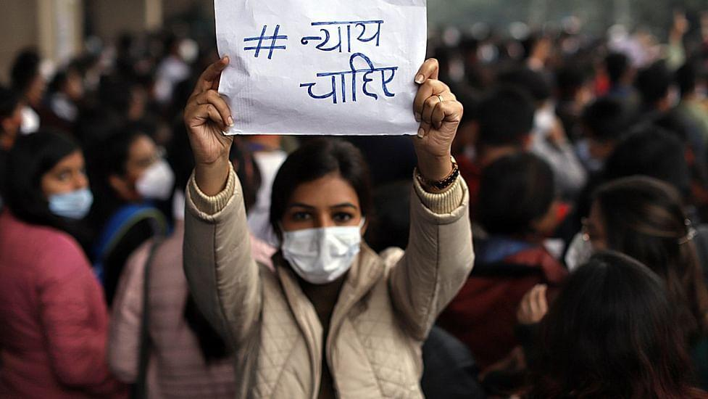
IMPACT
More the number of people affected and impacted by a story, more would be the worthiness of it.
More the people involved; it would make the news worthier.
DOCTORS PROTEST IN NEW DELHI
SOURCE: The Print

Slide 22

CONFLICT/SCANDALS/CONTROVERSIES
The public has a special place for any sort of argument, disagreement or tensions. They are quite actively interested to know all the details related to it. This quality makes the story worthier .
KOHLI VS GANGULY
SOURCE: DNA India

Slide 23

SUPERLATIVES
Audience has a very peculiar knack for extremes like best or worst, largest or smallest etc. The love that audience pour in for the superlative degree of adjectives make the story news-worthy.
NATIONAL FILM AWARDS 2019
SOURCE: Gulf News

Slide 24

HUMAN INTEREST
Any news story that connects with the masses emotionally is considered newsworthy. Those stories that could trigger the feelings of sorrow, pain, elation or other sentiments are considered news-worthy
DELHI HIGH COURT ON MARITAL RAPE EXEMPTION
SOURCE: News18

Slide 25

EDUCATIONAL PROGRESSION
Any story that tells the audience about new inventions, technologies and educates them about the significant developments that might impact the masses is considered newsworthy.
NASA SPACECRAFT TOUCHES THE SUN FOR THE FIRST TIME
SOURCE: NDTV

Slide 26
CONCLUSION
More the number of aforementioned factors, more will be the newsworthiness of a story.
Each story is a culmination of the mentioned factors.
Recognizing news-worthiness of a story is quite crucial in order to discern the time-sensitive and quintessential news pieces.

Slide 27
SOURCES OF NEWS

Slide 28

Any source that provides us with correct information on various topics for a good period of time is called a source of news. A journalist who understands and can use the sources quickly and effectively will discover more and better stories than who doesn’t.

Slide 29

RADIO
It is an audio medium used by many in today’s time. We can see people are relying on Radio as a source of information. Radio is prominent and seen in both rural and urban areas. If we talk about urban areas where we do not see many using radio at their houses instead they listen in their cars. Over decades radio has gained popularity and is a good source of news because it is broadcasted 24 hrs a day and provides the most recent news update to listeners.

Slide 30

NEWSPAPER
Credit for the oldest mass medium goes to the newspaper. Newspapers were the first to reach a mass audience, ultimately serving all classes. News sheets and reports published by various governments are among the first known examples of publications giving rise to the modern newspaper.

Slide 31

TELEVISION
The most convenient and latest source to gather news across the globe. It broadcasts informational contents, like news, sports events, movies and documentaries. It allows us to hear and view the event or any happening in another corner of the country.

Slide 32

PRESS RELEASE
A press release is an official statement delivered to members of the news media for the purpose of providing information, creating an official statement, or making an announcement directed for public release. Press releases are also considered a primary source because they are original informants for information.

Slide 33

HANDOUTS
Handouts are released on a variety of subjects like the daily proceedings of various ministries or departments.
What is handouts?
A handout is something that’s given to a person in need a useful handout for someone who doesn’t have a home might be food , money or a clothing

Slide 34

PRESS STATEMENT
What is press statement?
A press statement is utilized for a reactional statement. in other words, if an event has taken place and an EMB wants to make a public comment on it , this would be done in the further of a statement.
The information given to the media by known or authorized people is called press statement.

Slide 35

POLICE STATION
Journalists heavily depend on public as the accept and authoritative source of information relating to crime . lately , police has evolved into a key institution due to its expansion and centralisation also, journalists acknowledge a steady need of people for stories relating to crime and punishment and the continual flow of accounts of individual crimes from the police station provides cheap news content

Slide 36
USE OF ARCHIVES AS A SOURCE IN JOURNALISM

Slide 37

WHAT IS ARCHIVE?
Archives consist of records that have been hand-picked so at to be preserved permanently or for a long term on the grounds of their literary, evidentiary or historical value. They can include both publishes as well as unpublished materials in any format.
Since the materials archived are often unique and rare, the people in charge of caring for them, or Archivists, strive to preserve them for the use of future researchers.

Slide 38
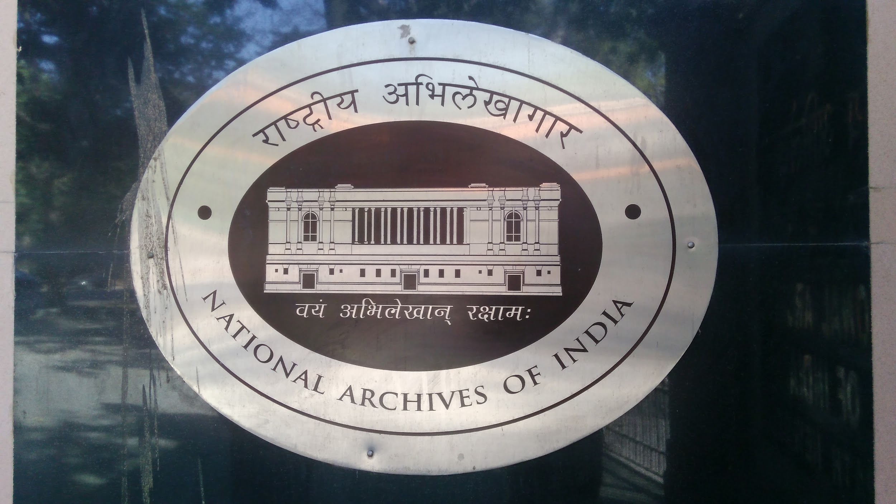

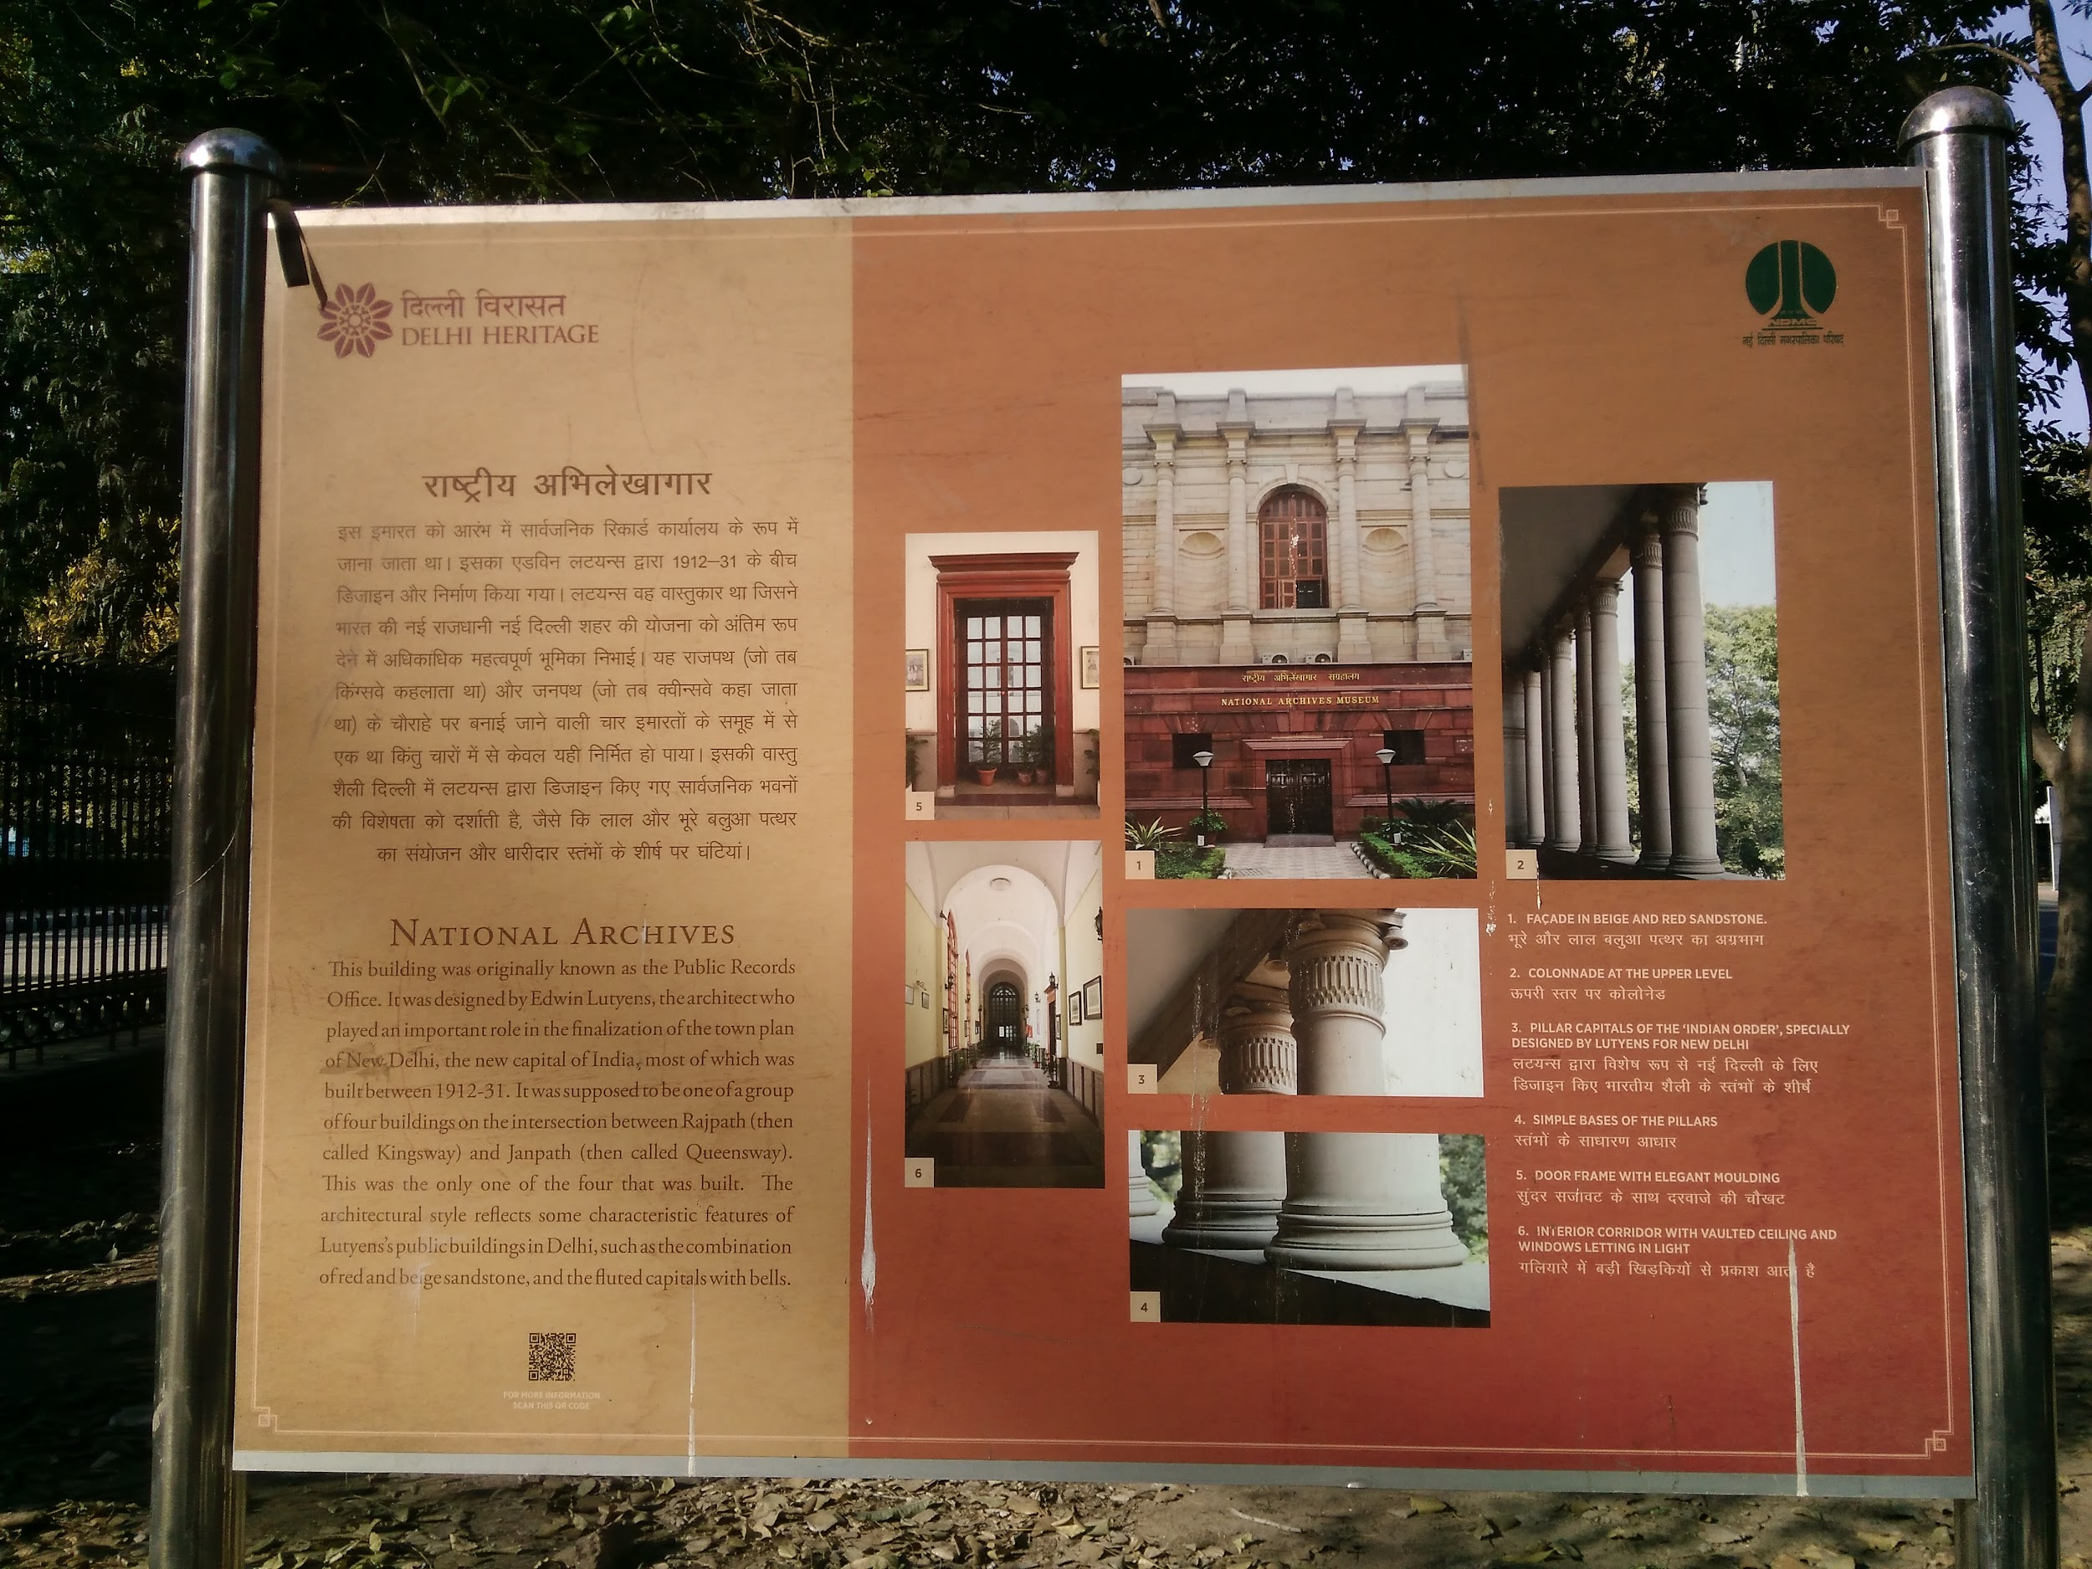
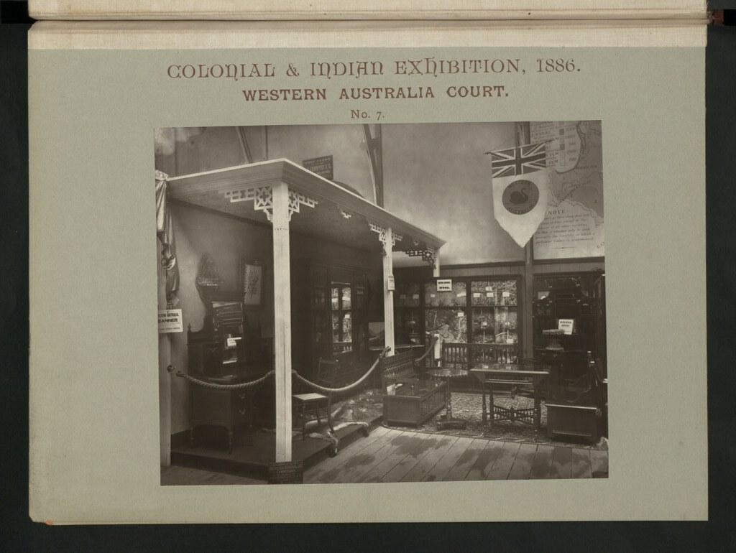
HISTORICAL NATIONAL ARCHIVES
The National Archives of India is the custodian of the records of enduring value of the Government of India. Established on 11 March, 1891 at Calcutta (Kolkata) as the Imperial Record Department, it is the biggest archival repository in South Asia. It has a vast corpus of records viz., public records, private papers, oriental records, cartographic records and microfilms, which constitute an invaluable source of information for scholars-administrators and users of archives.

Slide 39

JOURNALISM AND ARCHIVING
A large amount of journalistic content gets published every day and once it is retired, the same is archived for a later reference. They are useful and valuable in a variety of ways and, hence, must not be deleted at any point in time. Being able to access decade-old or century-old news could be crucial in order to understand the past.

Slide 40

IMPORTANCE OF ARCHIVING IN JOURNALISM
Archives can help in enhancing reader engagement and providing a fresh
perspective into the world of yesteryear. Newspapers have always recorded the
first draft of history and, hence, their archives could well be leveraged to gain
insight into people, places and times using their past content.

Slide 41
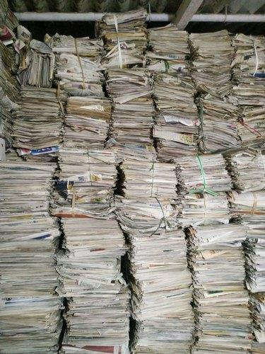
Journalists, too, are relying on archives more than ever. Archives are not just about (or for) the past, but also the present and the future. Journalists need archives for investigative reporting, fact checking and validation, preserving their own sources and reporting. From an archivist’s perspective, journalists need to learn how to write metadata and tag their content – information that will help provide a better use of it in the future.

Slide 42

TECHNOLOGY TO HARNESS VALUES FROM NEWS ARCHIVES
Many news archives support the researchers, their students and their long-term scholarly needs as more mining research methodologies are integrated into scholarly community. The challenges are great and the opportunities are significant and the news archives will be an important partner in many big-data and data mining researches.

Slide 43

NEWS ARCHIVE IN DIGITAL AGE
In the digital age, online journalism plays a crucial role and is considered even better than the conventional media. The news and magazine readers now prefer digital medium over the traditional types for many reasons, like multitasking, more news choices, ability to link to related news articles, 24/7 updates and the opportunity to “talk back to the media”.
The flexibility to access the previous-dated contents anytime with just a search and a click is considered to be an important value-addition. By utilizing the digital news archives ,the news readers are able to trace the shift in provided summaries and understand the changes in the discourse presentation.

Slide 44
Modern Gods
Journalism & The Internet in the 21st Century

Slide 45

Analysis of the Text
Since the subsection doesn’t go into much detail, the main aim of this presentation will be to look closely at & dissect the details of what it does say (to question what is said, what is omitted, what is glossed over, & of course, why) & to answer the one question related to it posed to us at the end:
How is internet used as a source of news? How do journalists ensure creditability while quoting sources from the internet?
Notes:
The subject matter at hand is extremely vast, but at 505 words, the text discussing it is not.

Slide 46
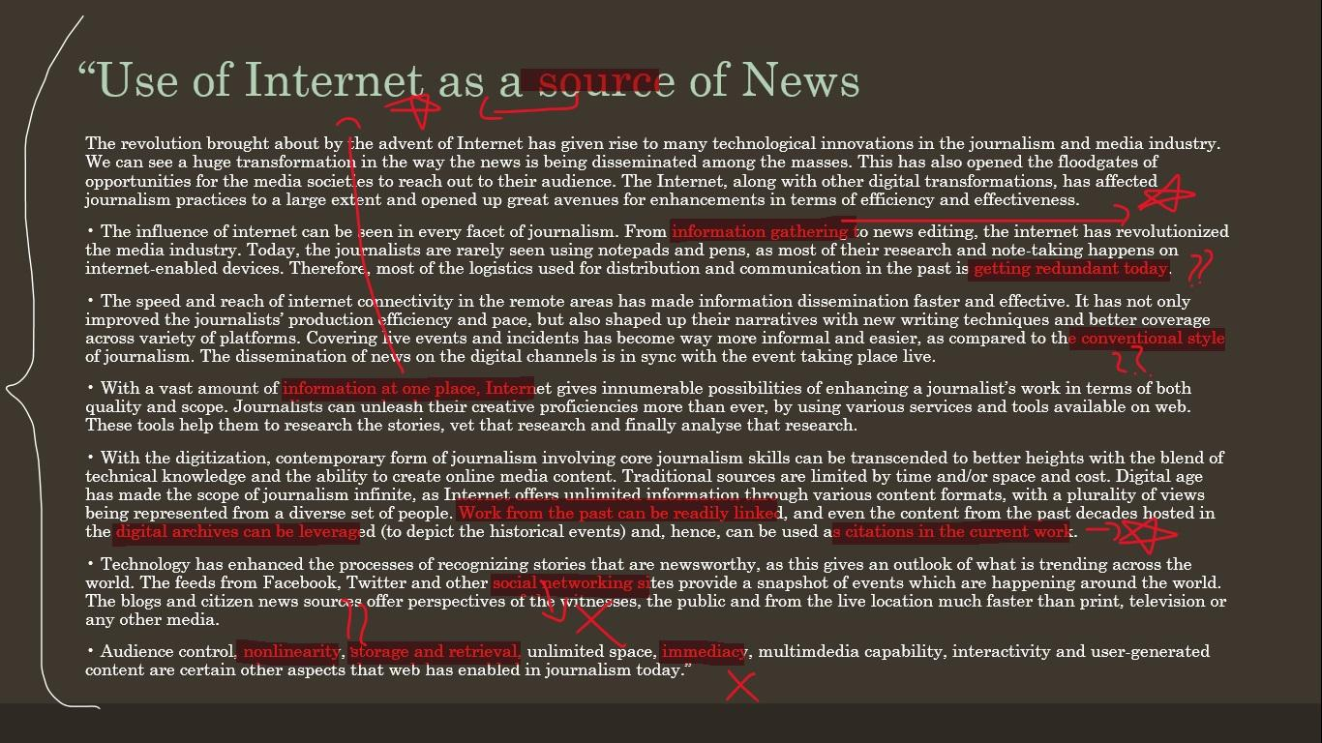
“Use of Internet as a source of News
The revolution brought about by the advent of Internet has given rise to many technological innovations in the journalism and media industry. We can see a huge transformation in the way the news is being disseminated among the masses. This has also opened the floodgates of opportunities for the media societies to reach out to their audience. The Internet, along with other digital transformations, has affected journalism practices to a large extent and opened up great avenues for enhancements in terms of efficiency and effectiveness.
• The influence of internet can be seen in every facet of journalism. From information gathering to news editing, the internet has revolutionized the media industry. Today, the journalists are rarely seen using notepads and pens, as most of their research and note-taking happens on internet-enabled devices. Therefore, most of the logistics used for distribution and communication in the past is getting redundant today.
• The speed and reach of internet connectivity in the remote areas has made information dissemination faster and effective. It has not only improved the journalists’ production efficiency and pace, but also shaped up their narratives with new writing techniques and better coverage across variety of platforms. Covering live events and incidents has become way more informal and easier, as compared to the conventional style of journalism. The dissemination of news on the digital channels is in sync with the event taking place live.
• With a vast amount of information at one place, Internet gives innumerable possibilities of enhancing a journalist’s work in terms of both quality and scope. Journalists can unleash their creative proficiencies more than ever, by using various services and tools available on web. These tools help them to research the stories, vet that research and finally analyse that research.
• With the digitization, contemporary form of journalism involving core journalism skills can be transcended to better heights with the blend of technical knowledge and the ability to create online media content. Traditional sources are limited by time and/or space and cost. Digital age has made the scope of journalism infinite, as Internet offers unlimited information through various content formats, with a plurality of views being represented from a diverse set of people. Work from the past can be readily linked, and even the content from the past decades hosted in the digital archives can be leveraged (to depict the historical events) and, hence, can be used as citations in the current work.
• Technology has enhanced the processes of recognizing stories that are newsworthy, as this gives an outlook of what is trending across the world. The feeds from Facebook, Twitter and other social networking sites provide a snapshot of events which are happening around the world. The blogs and citizen news sources offer perspectives of the witnesses, the public and from the live location much faster than print, television or any other media.
• Audience control, nonlinearity, storage and retrieval, unlimited space, immediacy, multimdedia capability, interactivity and user-generated content are certain other aspects that web has enabled in journalism today.”
Notes:
Text Analysis
Star = prime focus
? = analysis/clarification
X = not focus

Slide 47






Focus Areas
The Internet as a “Source” of news.
Journalistic Research Online.

Slide 48
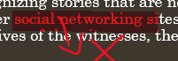

NOT Focus Areas
I. Social media & the advent of citizen journalism through microblogging & instant messaging sites.

Slide 49




Points that are interesting
“Media logistics of the past are getting redundant today” says unit that spends 8/9 subtopics discussing them.
Mainstream academia’s incessant desire to create a false dichotomy between Old & New Media.
Convenience.

Slide 50
Absence
Why indulgent & positive discussion of IT is markedly removed from not only most mainstream media but also academic spaces in all but esoteric forms.
Notes:
<modern divinity> <ignorance fosters an environment> <dependency of the web on unique individual voluntary labour> <reluctance to learn or familiarize or explain> <how this is both cased by & perpetuates a false dichotomy between old & new media>

Slide 51
II. New Order Old New Order
Let the narrative fall.
Notes:
<friedman defence> <the myth of new media> <evolutionary horizontality>

Slide 52
III. Precedence
Journalistic Research as a Recursive Process
Notes:
Those who are familiar with the adversarial model of dispute resolution, i.e. the model that the Indian judiciary follows, will know that one of the key features of this system is that it is precedence oriented, i.e. judgements from previous rulings form as much a basis for new ones as the present legislation. Judicial decree is as much a law as ‘the law’ itself.

Slide 53
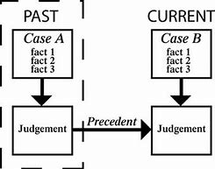
Those who are familiar with the adversarial model of dispute resolution (the model that the Indian judiciary follows) will know that one of the key features of this system is that it is precedence oriented, i.e. judgements from previous rulings form as much a basis for new ones as the legislation. Judicial decree is as much a law as ‘the law’ itself. A similar theme applies to journalistic research as well.
report
report

Slide 54
There is no greater journalistic resource than journalism that has already taken place.
But where does one find that?
Notes:
<Recursion diagram> put simply, an recursive object a is recursive if it returns to itself. Ultimately-
The answer to that question takes us back to question numero uno

Slide 55
Question Numero Uno
Focus Area Numero Uno
How is the internet used as a source of news?
The Internet as a “Source of News.”
Notes:
the first part of which, is ‘How is internet used as a source of news?’ as well as focus area numero uno. Answer:

Slide 56
‘The Internet’ is Not a Source
Come on

Slide 57
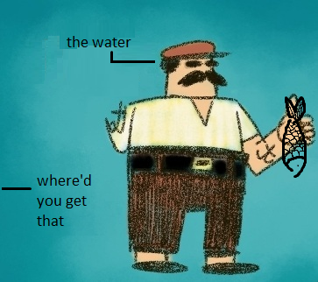
Saying you got your information from “The Internet” is like saying you got a fish from water
In the same vein, that asking someone where they got their information from, in this day & age, is like asking a man holding a fish next to a river where he found it.
Notes:
The internet is not a source, but rather where, a plethora of sources reside. jump back to slide Which is a very a small, seemingly pedantic distinction, but i promise its relevant

Slide 58
It doesn’t matter which medium people know or believe to have more credibility that. Because there is only one that can provide them the information they need when they need it at will.
After all, isn’t a source that which is sought?
Notes:
This also covers the question of credibility (second part of q1)

Slide 59
The Answer to the question, “How is the internet used as a source of news?” is simple.
Conveniently.
Notes:
back to 47

Slide 60
Everything is Accessible
The question is where to look.
Notes:
After all this critique of our society’s reluctance to get into the guts & grit web usage & functioning it would be embarrassing if I didn’t discuss some of the more practical aspects of – as is relevant for us – media dissemination, on the internet. I have compiled certain resources, using which, or simply of, will hopefully be of help to your daily lives, ik it is in mine.
Knowing Where to Look. If there is a will there is way etc etc. A working understanding of browsers is often not enough. But if you know where to look, everything can be found on the

Slide 61
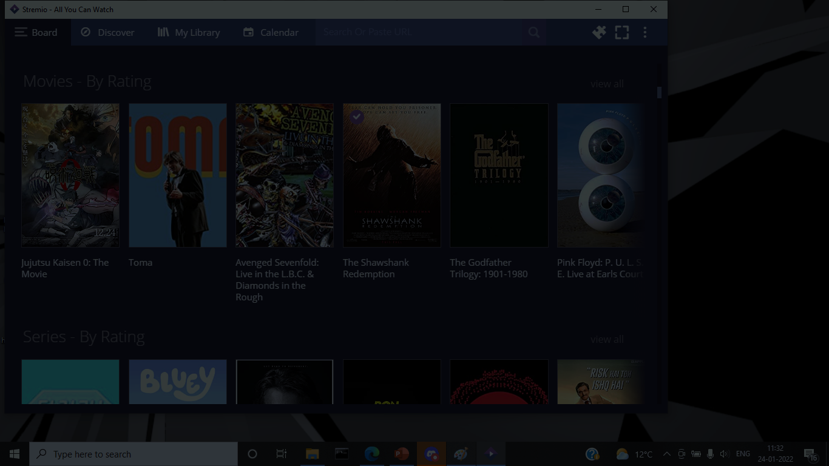
LibGen
Stremio
Academia.edu
12 Foot Ladder
indiankanoon.org
livelaw.in
Notes:
The pti business

Slide 62





?
Notes:
meet.google.com/tjz-hvio-erk
Everything that prints posts, but not everything that posts can afford to print (egs)
Case studys
Myth of credibility
Credence placed on print is legacy
Not a source of information but THE source of information
Means not source
No bigger journalistic resource than journalism that has already taken place
Adversarial law comparison
Ifnorance as barrier for acknowledging the true contributions of internet to journaliusm
In order to be a source, it must first be sought. active vs passive user interaction
Internet in relation to various types of journalism
No greater news source than news that’s already been broken

Slide 63
THANK YOU!

